Slide 1
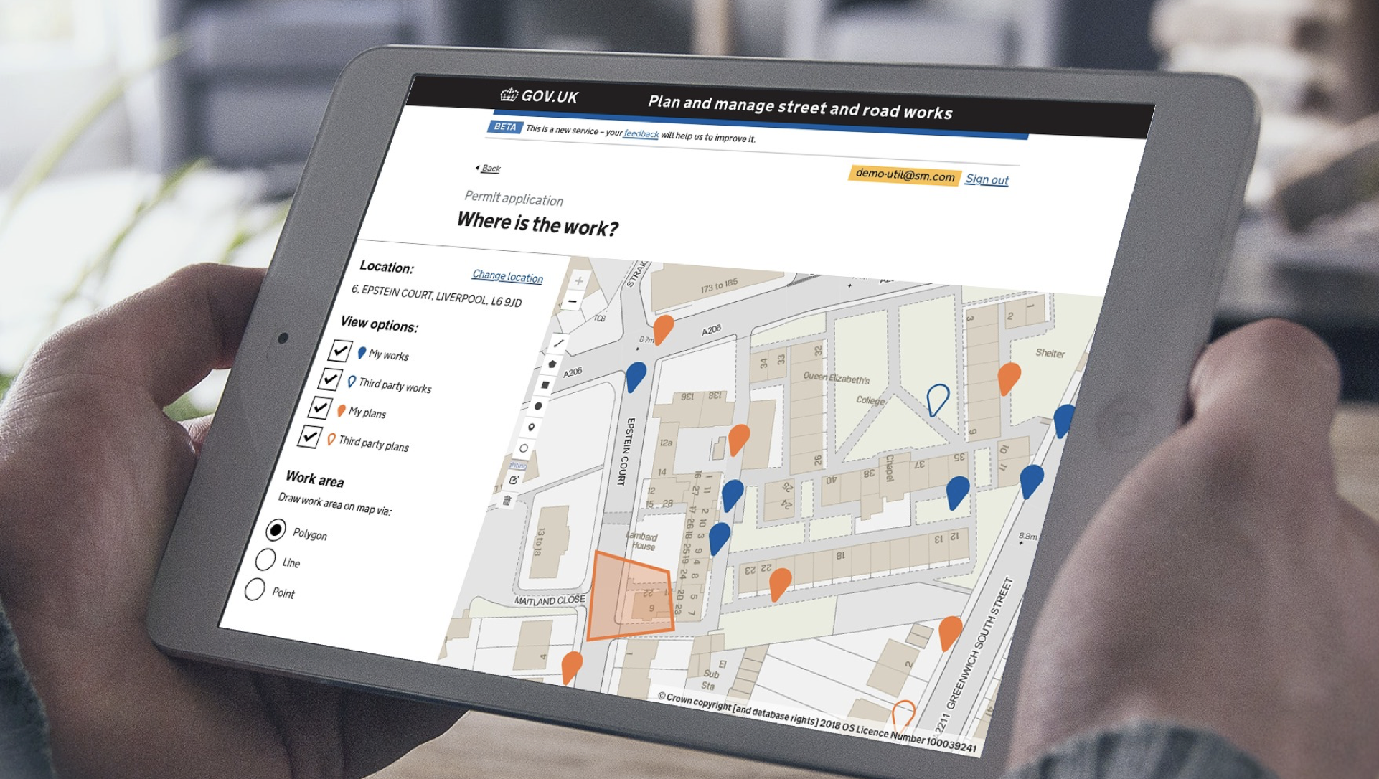

Playbook:
Part 2 (Deliver) &
3 (Measure)
@ Crown copyright

Slide 2
Contents
Deliver
Change management strategy
Communications approach
Training approach
Measure
Engagement and Training Needs Assessment and Progress Tracker
Progress and benefits dashboard

Slide 3
Introduction
This document is the second part of the Business change Playbook (Part 2: Deliver and Part 3: Measure).
It contains a set of tools, templates and guidance documents that will support you in delivering the transition as well as measuring the progress you have made at any given point.
While it includes Street Manager specific content, most of the information that needs to be inputted into these templates and tools is unique to your organisation, hence you will need to adapt the documents to fit your circumstances.
Each document comes with guidance on how to use the tools, the purpose of the document in question, as well as best practice on when to develop and what questions to consider when filling in the details. The detailed guidance is enclosed within each of the individual documents, whilst a summary is provided on each of the following one-pagers.
The methodologies included are intended to help you deliver and measure the success of the transition to Street Manager, however they are not prescriptive and it is up to you to decide whether and how to use each one of them. In addition, some activities may be more or less relevant to you depending on your organisation profile - please refer to the tables in the checklist for more information.

Slide 4
Checklist
We have developed a suggested checklist for you with recommended order of activities.
The checklist also provides view of which documents and tools are recommended for everyone, and which ones are more suited to a certain type of organisations.
Link to Checklist

Slide 5
Playbook:
Part 2 (Deliver)
@ Crown copyright

Slide 6



Change management strategy
Purpose & Content
Best Practice
Benefits
This document outlines the end-to-end approach and best practice to Change management to support the transition to Street Manager by enabling your stakeholders to act in a way that facilitates the progress of this project.
You do not need to use the exact approach included, however it is highly recommended that you develop and follow a comprehensive Change management strategy to ensure that your transition is successful.
It is recommended that you complete the Impact, Readiness and Stakeholder analyses for a comprehensive assessment of your stakeholder environment You can find these tools here.
Whatever methods and techniques you choose, make sure that you consider all internal and external stakeholders, and have realistic goals with measurable outcomes.
Ensure you are aware of and actioning any risks and opportunities that your stakeholder environment provides
Develop and execute a plan to manage the most complex factor of any change process - the people involved in it who will be impacted by or can impact the change
Link to document

Slide 7
Communications approach
Purpose & Content
Best Practice
Benefits
This document outlines the possible approaches, best practices and triggers for communications regarding Street Manager. It provides support for both internal stakeholders within your organisations and external stakeholders that sit outside of your direct organisation.
It is intended for guidance only.
Read through the comms approach in advance of planning and commencing any communication activities.
Consider which methods best suit you and your organisation.
Make sure to adjust to fit your stakeholder needs.
Use it in conjunction with the Engagement Needs Assessment
A means of tracking when key messages are being sent out
Manage different stakeholders both within and outside of your organisation
Ensure all stakeholders are engaged and up to date on information
Link to document

Slide 8
Training approach
Purpose & Content
Best Practice
Benefits
This document outlines the approach, best practice and some recommended techniques to deliver training to support the transition to Street Manager.
It is intended for guidance only.
Read through the Training approach in advance of planning and commencing any training activities.
Make sure to adjust to fit your stakeholder needs.
Use it in conjunction with the Engagement and Training Needs Assessment and Progress Tracker for more detailed analysis and monitoring.
A quick guide to best practices and recommended techniques that you may like to consider and build into your training plan that you would need to deliver in order to facilitate the transition to Street Manager
Link to document

Slide 9
Playbook:
Part 3 (Measure)
@ Crown copyright

Slide 10
Engagement and training needs assessment and progress tracker
Purpose & Content
Best Practice
Benefits
This tracker allows you to methodically assess the engagement / communication and training needs of all your stakeholders - both internal and external - as well as the progress made in completing them. The tool allows you to go down to individual stakeholder details.
This comprehensive tool allows you to get both a quick view of needs and progress via Dashboards, as well as into the detail by looking at the Needs assessment and Progress Tracker tabs.
Use this in conjunction with the Change management, Communications approach and Training approach for guidance on techniques
Record what type and intensity of engagement and training is needed and by when.
Track progress against each activity as well as how effective the intervention has been in achieving the desired outcome and take any actions as needed
Link to document

Slide 11
Progress of benefits tracker
Purpose & Content
Best Practice
Benefits
This document comes with best practice on how to identify, categorise, prioritise and plan the achievement of short and long-term benefits as well as automated tracker and dashboards to monitor progress made. ensuring you can easily see whether or not you are on track as well as when the benefit has been achieved.
A Benefits approach and tracker is usually started at the early stages of any project after the business case has been finalised.
Treat this as a live document and monitor any movements so that the benefits can be kept relevant and updated if needed in line with progress made.
Monitor the benefits that you are receiving from the introduction of Street Manager and track the progress of targets achievements through Key Performance Indicators.
Quick dashboard view allow you to easily communicate information to key stakeholders
Link to document

Slide 12
Questions
For any questions or comments, get in touch with us via:
streetmanager@dft.gov.uk
#businesschange slack channel
All documentation can be found here:
https://departmentfortransport.github.io/street-manager-docs/business-change/

